Slide 1




Virtual Congress July 12 – 14, 2020
EFFECT OF DIFFERENT INSOLE TYPES ON WEIGHT DISTRIBUTION
AND CENTRE OF PRESSURE
EXCURSION DURING UPRIGHT STANDING
ALFIO CARONTI MEDICANTU ITALY
TAIAN VIEIRA TALITA PEIXOTO PINTO CRISTINA ANSALDI

Slide 2
Effect of textured insoles on postural control during static upright posture following lower limb muscle fatigue.
Francesco Palazzo, Alessandra Nardi, Virginia Tancredi, Alfio Caronti, Gianpaolo Scalia Tomba, Pietro Lebone, Elvira Padua and Giuseppe Annino.
Effect of long term stimulation of textured insoles on postural control in healthy elderly.
Giuseppe Annino, Francesco Palazzo, Mohammad Alwardat, Vincenzo Manzi, Pietro Lebone, Virginia Tancredi, Paola Sinibaldi Salimei, Alfio Caronti, Michele Panzarino and Elvira Padua.
Effect of stimulating surface during static upright posture in the elderly.
Francesco Palazzo, Alfio Caronti, Pietro Lebone, Alessandra Proietti, Michele Panzarino and Giuseppe Annino.
……………………………………………………………………..

Slide 3

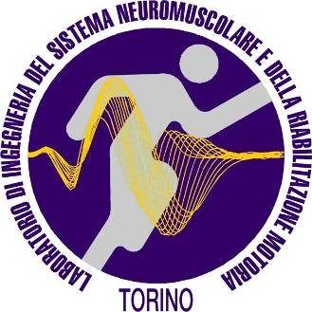




Effect of different insole types on weight distribution and centre of pressure excursion during upright standing
Alfio Caronti
(Doctor of Chiropractic / Professor in Motor Science)
Centro Medicantù, 22063 Cantù, Italy
alfiocaronti@libero.it
Taian Vieira, Talita Peixoto Pinto
Laboratorio di Ingegneria del Sistema Neuromuscolare (LISiN), Politecnico di Torino, 10129 Turin, Italy
PoliTo^{BIO}Med Lab, Centro Interdipartimentale, Politecnico di Torino, 10129 Turin, Italy
Cristina Ansaldi
Società Canottieri ARMIDA, 10145 Turin, Italy
Federazione Italiana Canottaggio, 00196 Rome, Italy
INTRODUCTION
Bipedal standing is a highly unstable condition, whereby small perturbations, triggered internally or by environmental factors, may lead to falls if not compensated for. It is a common experience that different subjects may respond differently to these perturbation, in particular when standing on different surfaces. It has been suggested that when our foot sole is in direct contact with natural composites, skin receptors are facilitated, providing a more accurate source of sensorial input likely to help subjects in standing more stably. Our goal here is to test this hypothesis on a sample of healthy subjects.
. METHODS - 2
DATA ANALYSIS - 2
Second, the weight distribution between limbs was computed from reaction forces collected with both force plates. The sum of vertical reaction forces provides the amount of body weight loaded on each force plate. The absolute difference between right-left loads normalised with respect to the total body weight was regarded as indicative of the amount of asymmetric load distribution.
STATISTICS
Data normality and the homogeneity of both verified. Differences in the total excursion of CoP and in load distribution were assessed with two-way ANOVA separately for each visual condition [5]). Student’s t-test was applied to evaluate differences between testing materials in total scores for postural sways and load distribution. Pearson correlation was applied to verify whether age could affect the differences between materials.
RESULTS - 2
EFFECT OF AGE ON POSTURAL DESCRIPTORS
There was a significant association between age and the total CoP excursion (Pearson R = 0.38; P = 0.048), though not between age and load distribution (R = 0.07; P = 0.700; Fig 2). This positive association for CoP excursion indicate the effect of the Si28 material is stronger for younger subjects, as the reduction in CoP excursion resulting from the use of the Si28 material was greater for younger individuals.
METHODS - 1
SUBJECTS
Thirty six healthy (14 females; Table 1) volunteers were asked to stand on two force-plates for 30 s while wearing two different pairs of insoles, one at a time. One insole was made of polyurethane (control) while the testing insole was made of polyurethane and natural by-products (Si28). All subjects were able to stand for 60 s without losing their balance and were engaged in regular physical activity; they practice rowing at their leisure time from 2 to 3 times a week.
A
Centre of Pressure total excursion
B
Amount of asymmetric load distribution
1.14
2.0
Pearson R = 0.07
P= 0.7
1.10
Regression line
1.6
1.06
1.2
1.02
Ratio values (Si28/control)
Ratio values (Si28/control)
RESULTS - 1
CENTRE OF PRESSURE TOTAL EXCURSION
A main effect of the Si28 material was observed for eyes closed (P=0.038) though not for eyes open (P=0.15). This result indicates the total excursion of CoP was significantly smaller with the Si28 than the control material, regardless of whether subjects stood with or without vibration.
AMOUNT OF ASYMMETRIC LOAD DISTRIBUTION
As per the CoP total excursion, similar considerations can be drawn for the amount of asymmetric load distribution. Even though load was more symmetrically distributed when subjects stood with the Si28 material, a statistically significant difference was observed only for the eyes closed condition, without force plate vibration (P=0.023).
TOTAL SCORES FOR POSTURAL SWAYS AND LOAD DISTRIBUTION
Statistical significance was observed also when pooling together the total CoP excursion and the amount of asymmetric load distribution across the four testing conditions. An average difference of 40 mm was observed between materials for the total CoP excursion, whereby postural sways were significantly smaller with than without the Si28 material (t-test, P=0.038; Figure 1A). Similarly, a significant decrease in the amount of total asymmetric loading between limbs was observed when subjects stood over the Si28 material (t-test, P=0.001; Figure 1B).
0.98
Pearson R = 0.38
P = 0.048
0.8
0.94
0.4
Table 1: Sample, descriptive data reported with mean (standard deviation).
0.90
20
30
40
50
60
70
80
0.0
20
30
40
50
60
70
80
 | Male (N=22) | Female (N=14)
Age (years) | 47.1 (17.4) | 38 (14.8)
Body mass (kg) | 69.3 (5.0) | 59.4 (6.0)
Height (cm) | 176.3 (5.5) | 162.7 (5.5)
Age (years)
Age (years)
Fig. 2: Scatter plot showing ration values separately for the CoP total excursion (A) and the amount of asymmetric load distribution (B).
CONCLUSION
Results reported here confirm the hypothesis that the Si28 material lead to smaller sways of the centre of pressure and to a more evenly distribution of load between limbs. This effect seems to be stronger in younger individuals, possibly because younger subjects are more likely free from balance-related deficits. Considering that exercises and daily activities generally demand the maintenance of an appropriate equilibrium, results presented here expectedly indicate subjects are less prone to lose balance when standing with their feet in contact with the testing material.
EXPERIMENTAL PROTOCOL
Four stabilometric trials were applied while subjects stood with each of the two insoles:
eyes open without force plate vibration
eyes closed without force plate vibration
eyes open with 30Hz force plate vibration
eyes closed with 30Hz force plate vibration
Trials were conducted at the order just described with 1 min intervals between trials. Test duration (30 s) was sufficiently high to ensure the stationarity of stabilometric data [1]. Feet position over the force plate was kept constant across the testing conditions, minimising any potential geometric effect on the stabilometric descriptors [2].
DATA ANALYSIS
Two stabilometric descriptors were computed.
First, the size of postural sway was computed from the total excursion of the feet Centre of Pressure (CoP). CoP position was computed from the reaction forces as described by Vieira et al [3], separately for each feet and then averaged to provide the global, CoP position. The total CoP excursion was then calculated as the summation of CoP absolute displacements [4].
ACKNOWLEDGEMENTS
A
Centre of Pressure total excursion
B
We would like to thank all volunteers who dedicated their time for taking part in this study, the Rowing Club ARMIDA for providing us with facilities necessary for carrying on the study, rowing coaches who assisted with the recruitment of all participants.
Amount of asymmetric load distribution
1100
*
34
*
Mean
1060
30
Standard deviation
REFERENCES
[1] Carpenter MG, Frank JS, Winter DA, Peysar GW (2001) Gait Posture 13:35–40
[2] Chiari L, Rocchi L, Cappello A (2002) Clin Biomech 17:666–677.
[3] Vieira TM, Oliveira LF, Nadal J (2009) Brazilian J Med Biol Res 42:665–673.
[4] Prieto TE, Myklebust JB, Hoffmann RG, et al (1996) IEEE Trans Biomed Eng 43:956–966.
[5] Dawson B, Trapp RG (2004) Basic & Clinical Biostatistics, 4th ed. Lange Med. Books-McGraw-Hill
1020
26
% w.r.t. total body weight
mm
22
980
18
940
14
900
10
860
Control
Si28
6
Control
Si28
Testing material
Testing material
XXIII ISEK Congress
International Society of Electrophysiology and Kinesiology
Nagoya, Japan, July 11-14, 2020
Fig. 1: Mean and standard deviation for the CoP total excursion (A) and for the amount of asymmetric load distribution (B). * statistical significance at P<0.05.

Slide 4
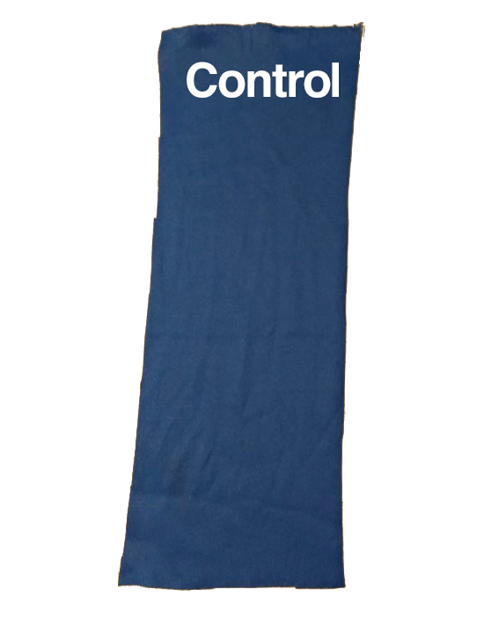
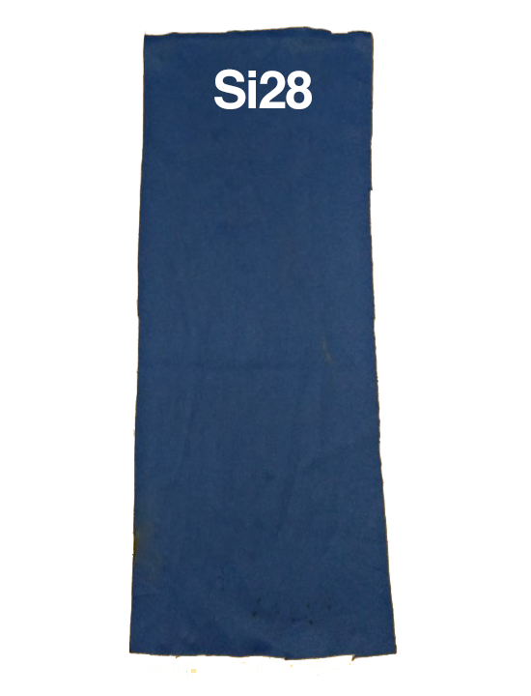
Synthetic
material
Natural material

Slide 5
